Slide 1
Virtual Mouse Implementation using OpenCV

Slide 2
Abstract
Hand Gesture Recognition plays a key role in human-computer interactions. As we can see that there are so many new Technological advancements happening such as biometric authentication which we can see frequently in our smart phones, similarly hand gesture recognition is a modern way of human-computer interaction i.e., we can control our system by showing our hands in front of webcam and hand gesture recognition can be useful for all kinds of people. Based upon this idea this paper is presented. This paper provides a detailed explanation to the algorithms and methodologies for the color detection and virtual mouse
Index Terms—Computer Vision, Open CV, Deep Learning, Image Processing.

Slide 3
Existing system:
A Computer Mouse is an input device that helps to point and to interact with whatever that is being pointed. There are so many types of mouse in the current trend, there’s the mechanical mouse that consists of a single rubber ball which can rotate in any direction and the movement of the pointer is determined by the motion of that rubber ball. Later the mechanical mouse is replaced by the Optical Mouse.
Optical Mouse consists of a led sensor to detect the movement of the pointer. Years Later the laser mouse was introduced to improve the accuracy and to overcome the drawbacks of the Optical Mouse. Later as the Technology has been increased drastically wireless mouse was introduced so as to enable hassle free movement of the mouse and to improve the accuracy.
No Matter how much the accuracy of the mouse increases but there will always be limitations of the mouse as the mouse is a hardware input device and there can be some problems like mouse click not functioning properly ad etc., as the mouse is a hardware device like any other physical object even the mouse will have a durability time within which is functional and after its durability time we have to change the mouse
Disadvantage :
There will always be limitations of the mouse as the mouse is a hardware input device and there can be some problems like mouse click not functioning properly.
the mouse is a hardware device like any other physical object even the mouse will have a durability time within which is functional and
after its durability time we have to change the mouse

Slide 4
Proposed system:
As the technology increase everything becomes virtualized such as speech recognition. Speech Recognition is used for recognition and translation of the spoken language into text. Thus, Speech Recognition can replace keyboards in the future, Similarly Eye Tracking which is used to control the mouse pointer with the help of our eye. Eye Tracking can replace mouse in the future.
Gestures can be in any form like hand image or pixel image or any human given pose that require less computational difficulty or power for making the devices required for the recognitions to make work. Different techniques are being proposed by the companies for gaining necessary information/data for recognition handmade gestures recognition models. Some models work with special devices such as data glove devices and color caps to develop a complex information about gesture provided by the user/human.
Advantages:
Virtual Mouse using Hand gesture recognition allows users to control mouse with the help of hand gestures.
system’s webcam is used for tracking hand gestures.
Computer vision techniques are used for gesture recognition. OpenCV consists of a package called video capture which is used to capture data from a live video.
main thing we need to identify are the applications the model is going to develop so the development of the mouse movement without using the system mouse.

Slide 5
Modules
1) Collection information,
2) Checking devices (like webcam) working properly or not,
3) Collection tape or finger ribbon, which should be fit to the fingers,
4) Import packages like NumPy, OpenCV, pynput.mouse, tkinter,
5) Implement The Open Gesture Operation,
6) Fine Tuning.
Libraries :
OpenCV :
Open CV (Open Source Computer Vision Library) is an open library of python that is mainly aimed at real-time computer-vision. It is also available in C++ and Java. It is an open source machine learning software library. OpenCV library is imported into the python using the code ‘import cv2’.
pynput :
package pynput.mouse contains classes for controlling and monitoring the mouse.
tkinter :
Python offers multiple options for developing GUI (Graphical User Interface). Out of all the GUI methods, tkinter is most commonly used method. It is a standard Python interface to the Tk GUI toolkit shipped with Python. Python with tkinter outputs the fastest and easiest way to create the GUI applications. Creating a GUI using tkinter is an easy task.

Slide 6
Libraries :
Pandas:
pandas is an open source, BSD-licensed library providing high-performance, easy-to-use data structures and data analysis tools for the Python programming language.
Numpy:
NumPy is a general-purpose array-processing package. It provides a high-performance multidimensional array object, and tools for working with these arrays. It is the fundamental package for scientific computing with Python.
MatPlotLib:
matplotlib.pyplot is a plotting library used for 2D graphics in python programming language. It can be used in python scripts, shell, web application servers and other graphical user interface toolkits
Scikit-learn:
Scikit-learn is a free machine learning library for Python. It features various algorithms like support vector machine, random forests, and k-neighbors, and it also supports Python numerical and scientific libraries like NumPy and SciPy.

Slide 7
SYSTEM SPECIFICATIONS
SOFTWARE REQUIREMENTS:
OS : Windows
Python IDE : python 2.7.x and above
Pycharm IDE,
Anaconda 3.5
Setup tools and pip to be installed for 3.6.x and above .
HARDWARE REQUIREMENTS:
RAM : 4GB and Higher
Processor : Intel i3 and above
Hard Disk : 500GB: Minimum

Slide 8
b. Hardware Requirements
RAM : 4GB and Higher
Processor : Intel i3 and above
Hard Disk : 500GB: Minimum
NON Functional Requirements
Secure access of confidential data (user’s details). SSL can be used.
24 X 7 availability.
Better component design to get better performance at peak time
Flexible service based architecture will be highly desirable for future extension

Slide 9
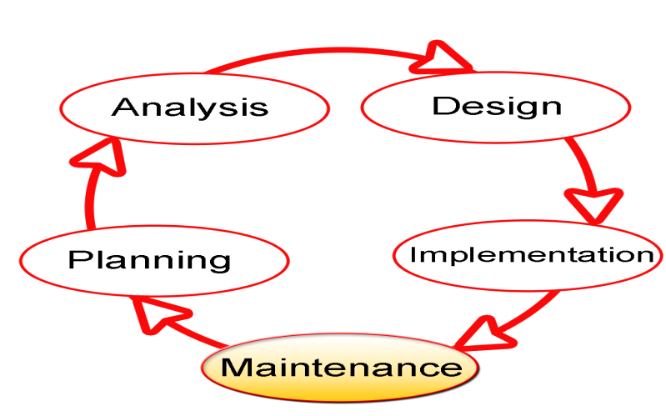
SDLC Methodologies
The Software Development Lifecycle (SDLC) for small to medium database application development efforts.
This project uses iterative development lifecycle, where components of the application are developed through a series of tight iteration. The first iteration focus on very basic functionality, with subsequent iterations adding new functionality to the previous work and or correcting errors identified for the components in production.

Slide 10
The six stages of the SDLC are designed to build on one another, taking outputs from the previous stage, adding additional effort, and producing results that leverage the previous effort and are directly traceable to the previous stages. During each stage, additional information is gathered or developed, combined with the inputs, and used to produce the stage deliverables. It is important to not that the additional information is restricted in scope, new ideas that would take the project in directions not anticipated by the initial set of high-level requirements or features that are out-of-scope are preserved for later consideration.

Slide 11
UML DIAGRAMS

Slide 12
Use Case :

Slide 13
Sequence Diagram

Slide 14
Collaboration Diagram

Slide 15
Activity Diagram

Slide 16
Activity Diagram:

Slide 17
Class Diagram

Slide 18
Component Diagram
dataset
server
modules
algorithms

Slide 19
State Diagram

Slide 20
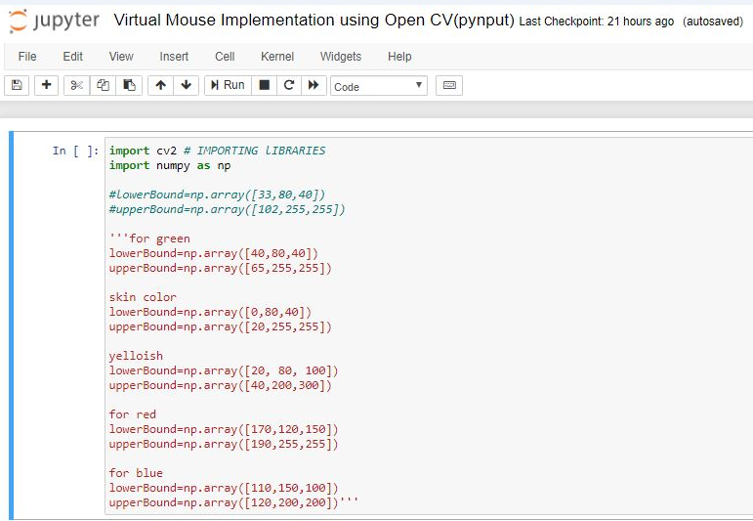
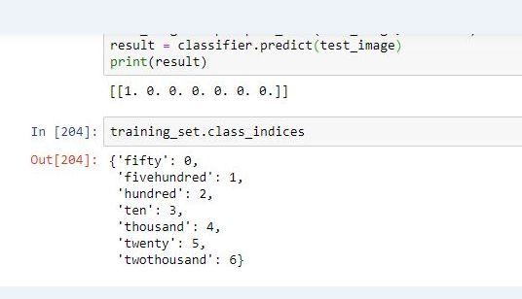
Coding

Slide 21
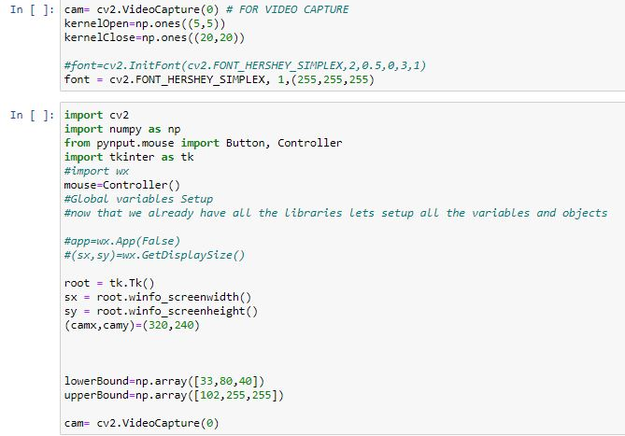

Slide 22
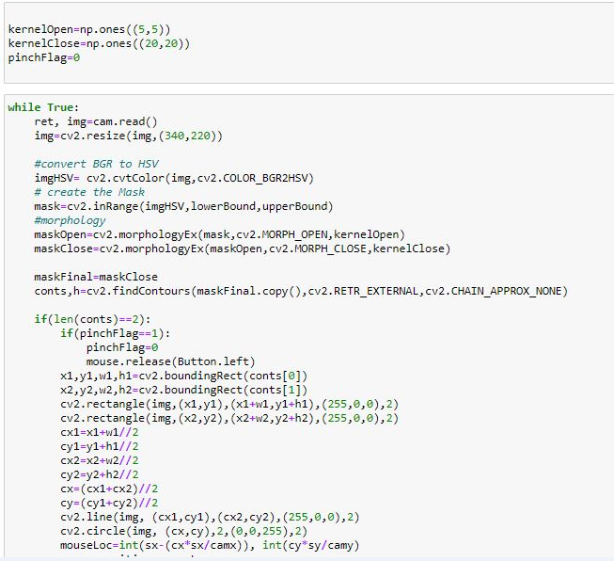

Slide 23
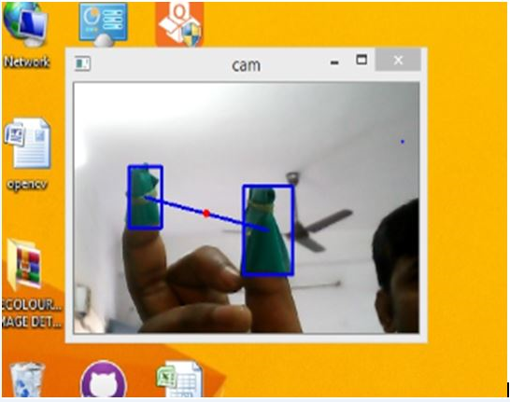
Visualization

Slide 24
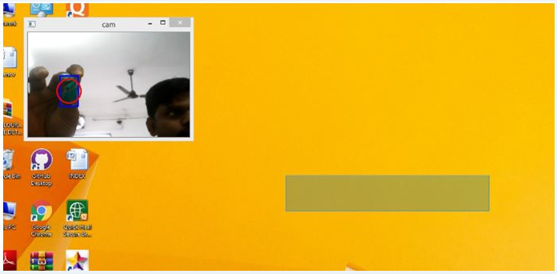

Slide 25
